Slide 1


Slide 2

Local search algorithms are useful for solving optimization problems by exploring search spaces systematically
This systemiticity is achieved by keeping one or more paths in memory and by recording which alternatives have been explored at each point along the path.
When a goal is found, the path to that goal constitutes a solution to the problem.
In many problems, however, the path to the goal is irrelevant.

Slide 3

State space = set of configurations
  Find a configuration satisfying your constraints, e.g., n-queens
what matters is the final configuration of queens, not the order in which they are added.
In such cases, we can use local search algorithms
Keep a single current node (rather than multiple paths) and generally move only to neighbors of that node.
  Typically, the paths followed by the search are not retained, therefore, use very limited memory
  Find reasonable solutions in large state spaces.

Slide 4

Although local search algorithms are not systematic, they have two key advantages:
(1) they use very little memory—usually a constant amount;
(2) they can often find reasonable solutions in large or infinite (continuous) state spaces for which systematic algorithms are unsuitable.
For example, nature provides an objective function—reproductive fitness—that Darwinian evolution could be seen as attempting to optimize, but there is no “goal test” and no “path cost” for this problem.

Slide 5


A landscape has both “location” (defined by the state) and “elevation” (defined by the value of the heuristic cost function or objective function).

Slide 6

The hill-climbing search algorithm, is the most basic local search technique.
A loop that continually moves in the direction of increasing value, i.e., uphill.
Terminates when it reaches a peak where no neighbor has a higher value
Doesn’t look ahead beyond the immediate neighbors of the current state.
The algorithm does not maintain a search tree, so the data structure for the current node need only record the state and the value of the objective function.
Hill climbing sometimes become greedy local search because it grabs a good neighbor state without thinking ahead about where to go next.

Slide 7


Slide 8

Pick a random point in the search space
2. Consider all the neighbors of the current state
3. Choose the neighbor with the best quality and move to that state
4. Repeat 2 thru 4 until all the neighboring states are of lower quality
5. Return the current state as the solution state.

Slide 9

Greedy Local Search: grabs a good neighbor state without thinking about where to go next
  However, greedy algos do make good progress generally towards the solution
Unfortunately, hill-climbing
  Can get stuck in local maxima
  Can be stuck by ridges
  Can be stuck by plateaux

Slide 10

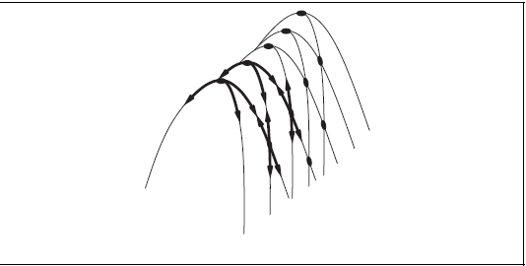
Ridges result in a sequence of local maxima that is very difficult for greedy algorithms to navigate.
plateau is a flat area of the state-space landscape. It can be a flat local maximum, from which no uphill exit exists.
The hill-climbing algorithms are incomplete—they often fail to find
a goal when one exists because they can get stuck on local maxima.

Slide 11

Stochastic Hill Climbing: chooses at random from among the uphill moves; the probability of selection can vary with the steepness of the uphill move.
First-choice Hill Climbing: First-choice hill climbing implements stochastic hill climbing by generating successors randomly until one is generated that is better than the current state. This is a good strategy when a state has many (e.g., thousands) of successors.
The hill-climbing algorithms described are incomplete often fail to find a goal because they can get stuck on local maxima.
Random-restart Hill Climbing: It conducts a series of hill-climbing searches from randomly generated initial states, until a goal is found.
It is trivially complete with probability approaching 1, because it will eventually generate a goal state as the initial state.

Slide 12
The success of hill climbing depends very much on the shape of the state-space landscape:
If there are few local maxima and plateaux, random-restart hill climbing will find a good solution very quickly.
On the other hand, many real problems have a complex landscape.
NP-hard problems typically have an exponential number of local maxima to get stuck on.
Despite this, a reasonably good local maximum can often be found after a small number of restarts.

Slide 13

Using calculus simple optimization for single variable functions are obtained.
f(x) = x² + 2x is optimized with solution x = -1 yielding the minimum value f(-1) = -1.
This technique suffices for simple functions with few variables.
However, optimizing functions of several variables, in which case the solution can only be obtained computationally.
There may be many objectives to achieve having many variables and solution is single cost fn. as an objective fn.

Slide 14

we don’t necessarily need to find a strictly optimal value — finding a near-optimal value would satisfy our goal.
Simulated annealing is the technique by which we introduce a degree of stochasticity, potentially shifting from a better solution to a worse one, in an attempt to escape local minima and converge to a value closer to the global optimum.
In metallurgy, annealing is the process used to temper or harden metals by heating them to a high temperature and then gradually cooling them, thus allowing the material to reach a low energy crystalline state.
Gradient descent algorithm is used to reach to global minimum, i.e. minimum energy state.

Slide 15
In SA algorithm, define the initial state at a high temperature, and a minimum temperature, on the order of 10⁻⁴.
For each distinct temperature value, run the core optimization routine a fixed number of times.
Instead of picking the best move, however, it picks a random move.
If the move improves the situation, it is always accepted. Otherwise, the algorithm accepts the move with some probability less than e^{(f(c)-f(n))} where c is the current solution and n is the neighboring solution.
A neighboring solution is found by applying a slight perturbation to the current solution.
This randomness is useful to escape of getting trapped in local minima.

Slide 16


Idea: escape local maxima by allowing some "bad" moves but gradually decrease their frequency

Slide 17
The probability decreases exponentially with the “badness” of the move—the amount ΔE by which the evaluation is worsened.
The probability also decreases as the “temperature” T goes down: “bad” moves are more likely to be allowed at the start when T is high, and they become more unlikely as T decreases.
If the schedule lowers T slowly enough, the algorithm will find a global optimum with probability approaching 1.
Finding a near-optimal value would satisfy the goal.

Slide 18
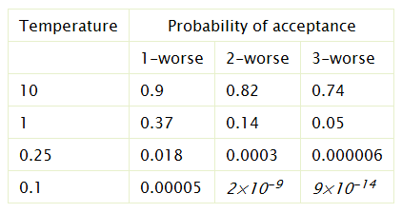
If Value[Next] is close to Value[Current], the assignment is more likely to be accepted.
  If the temperature is high, the exponent will be close to zero, and the probability will be close to 1.
  As the temperature approaches zero, the exponent approaches -∞, and the probability approaches zero.

Slide 19
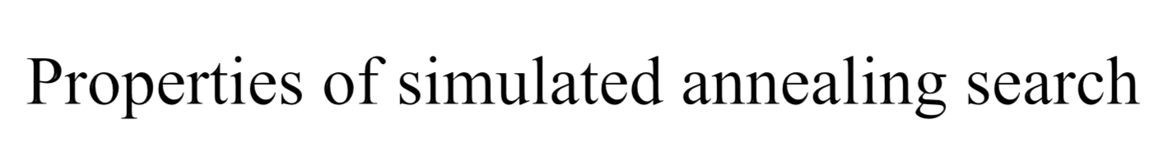
One can prove: If T decreases slowly enough, then simulated annealing search will find a global optimum with probability approaching 1
Widely used in VLSI layout, airline scheduling, etc.

Slide 20

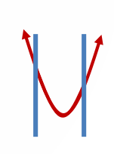
Previous problems objective functions are unconstrained, meaning no boundary or soft boundary of decision variables.
An optimization problem is constrained if solutions must satisfy some hard constraints on the values of the variables.
The difficulty of constrained optimization problems depends on the nature of the constraints and the objective function.
The best-known category is that of linear programming (LP) problems where the objective function is linear.
LP allows the constraint region to be any convex region and the objective to be any function that is convex within that region.

Slide 21
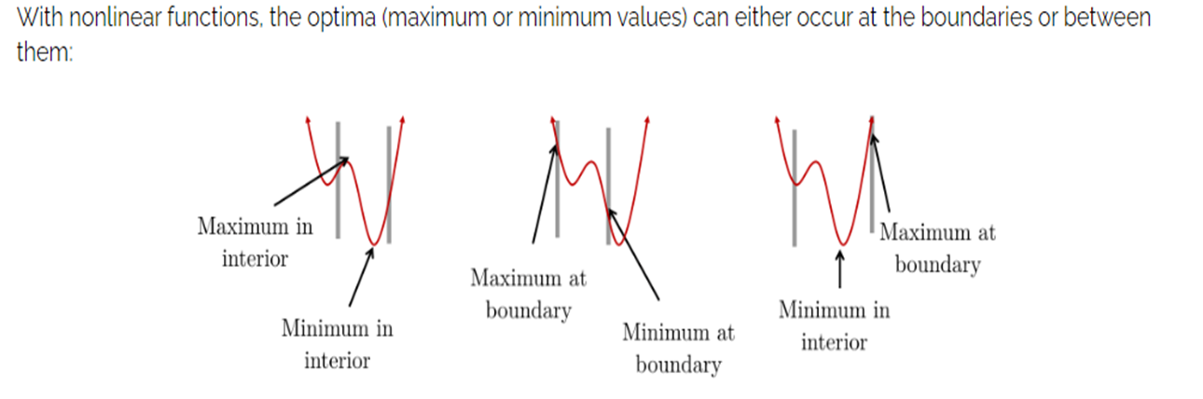
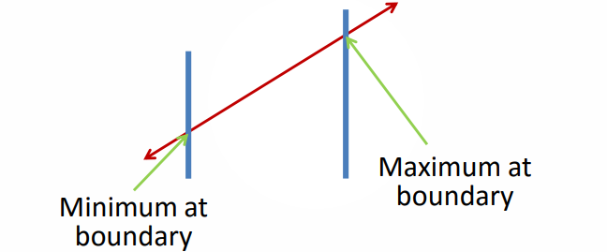
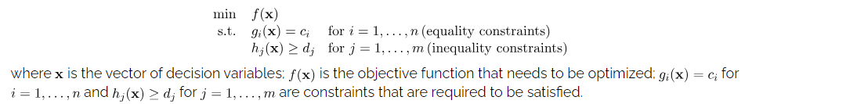
With linear functions optimum values occur only at the boundaries

Slide 22
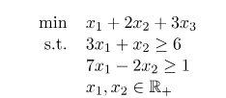
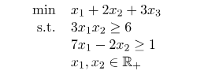
LP covers the cases in which the objective function is linear and all constraints are also linear.
Nonlinear Programming (NLP) refers to the problems where the objective function or some constraints are nonlinear.
Advantages Solution Methods
Efficient Resource Allocation Convex Optimization
Improved Decision-Making Linear Programming
Reduced Costs Nonlinear Programming

Slide 23

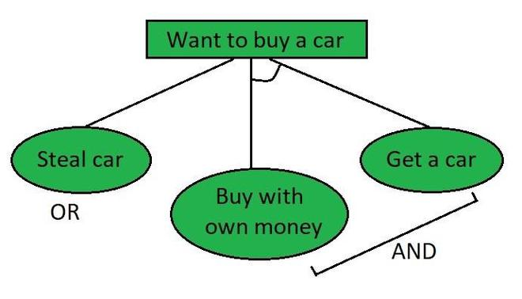
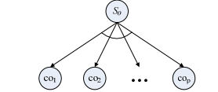
IN an OR graph, several arcs may emerge from a single node, indicating a variety of ways in which the original problem might be solved.
Problem is decomposed into p subproblems.
Original problem is solvable when all p nodes are solvable.
This decomposition, or reduction, generates arcs that we call AND arcs.
One AND arc may point to any number of successor nodes

Slide 24
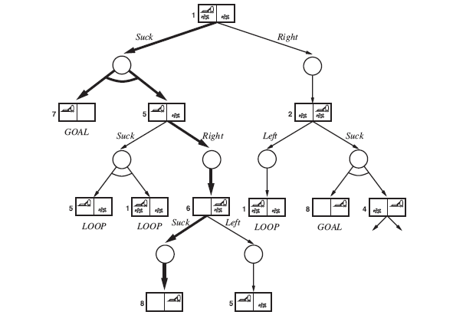
For example, the Suck action in state 1 leads to a state in the set {5, 7}, so the agent would need to find a plan for state 5 and for state 7.

Slide 25
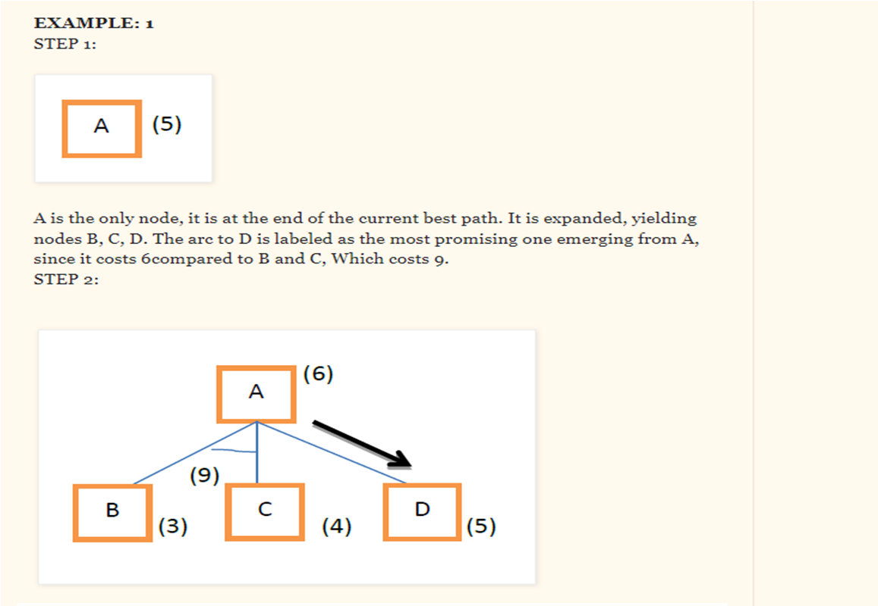

Slide 26
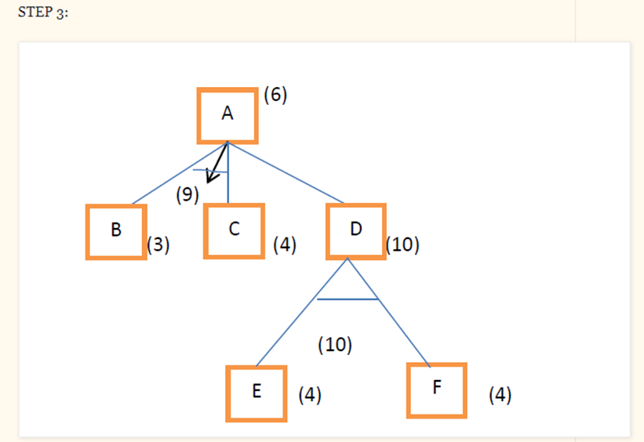
Node D is chosen for expansion

Slide 27
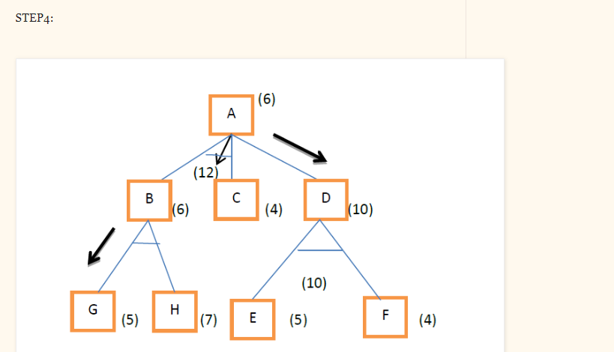
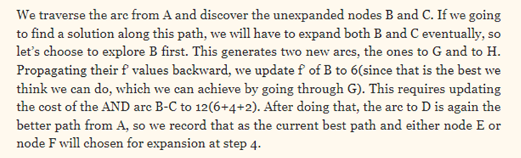

Slide 28
